Slide 1


Artist Support Grant
Application Workshop
[Date]
[Location, Region Details]

Slide 2


North Carolina Arts Council’s
Artist Support Grant
The Artist Support Grant provides direct support to individual artists for professional and artistic development, either to enhance their skills and abilities to create work, or to improve their business operations and capacity to bring the work to audiences.

Slide 3

Disciplines
The Artist Support Grant is intended to support a broad range of talented visual, performing, literary, and interdisciplinary artists.

Slide 4
18 Regions Award Artist Support Grants

Slide 5
Eligibility for application

Slide 6

Emerging and established artists
Eligible candidates may be either emerging or established artists. Applicants should demonstrate a commitment to spending a significant portion of their time on their work as artists.

Slide 7
Individuals and groups
Individuals and Artist Collectives
Both individual artists and small, unincorporated groups of collaborating artists are eligible to apply.
All members of a collaborating team must be North Carolina residents, live in the region where they are applying, and meet the other eligibility requirements. Résumés documenting residence from all team members should be included with the application.

Slide 8
Residency
Artists should have lived in the region where they are applying continuously for at least one year prior to the consortium’s application deadline. An applicant must be at least 18 years old and either a U.S. citizen or a lawful permanent resident. Proof of residence and status may be required by the consortium. Artists who live in more than one region should apply only where they spend the majority of the year.

Slide 9

Who are NOT eligible
Multiple awards
Artists who are sole proprietors of organizations that have already received funding for FY 2026-27 from the NC Arts Council are ineligible to apply.
Conflict of interest
Current board and staff members of the participating partner organizations and their family members are not eligible to apply for the award.
Students
The Artist Support Grant is intended for adult, non-student artists. Artists enrolled full-time in undergraduate or associate degree-granting programs may not apply for the grant.

Slide 10
Scope of funding
What the grant will fund

Slide 11
Completion or presentation of a new work
Cost of resources necessary to complete or present a significant new work.
Examples include:
Purchasing art supplies
Equipment
Space rental

Slide 12
Career promotion
Projects aimed at advertising artists’ work and/or demonstrating their skill level.
Examples include:
Websites
Portfolios
Audio-visual documentation
Online presentation

Slide 13
Training
Costs to attend a class or workshop (in-person or virtual) aimed at either enhancing the artists’ skill level or professional development.
Such as attending a master class or workshop taught by acknowledged authorities in their medium.

Slide 14
Travel
Costs of transportation, lodging, and food for training, professional conferences, or research.

Slide 15
Artists fees
Up to 50% of grant amount may be used towards artist fees!

Slide 16
What the grant will NOT fund
Scholarships for undergraduate- or graduate-level education
Projects that support or oppose a particular candidate for public office
Projects that are exclusive to members of a particular religious faith group
Non-profit initiatives
Projects that do not have a direct effect on the applicant’s growth as an artist

Slide 17
Evaluation criteria

Slide 18

Artistic merit
Demonstrated talent in an art form and overall excellence of the artist’s work
Clear commitment to a career as a practicing professional artist

Slide 19

Project Merit
Benefit of the proposed project to the artist’s professional growth
Feasibility of the proposed project

Slide 20
The application

Slide 21
Project narrative
Your Project Narrative should explain your proposed project and how it will have an impact on your career as an artist. Include a detailed project description:
Describe your project and the proposed use of funds.
Explain what this project will enable you to do that you are unable to do now.
Summarize how this project will advance your career or development as an artist.

Slide 22
Your proposal is competitive. Make sure it is:
Feasible
Don’t propose a project that seems beyond your capacity either in terms of cost, access, or other factors.
A logical step for you
It should make sense why the workshop tuition, studio equipment, etc. Is relevant and helpful to you at this point in your career.

Slide 23
Project narrative: Additional tips
Use simple, declarative sentences, active voice—and get to the point. Observe the space or page limits.
Say what you need to say as efficiently as possible.
The narrative is not an artist statement.
Keep your answers focused on the practical needs and outcomes of your project.
Who, what, when, where, why and how.
If you find, after you’ve answered the application queries, that you haven’t addressed one or more of the questions above, you might want to revisit your responses.

Slide 24
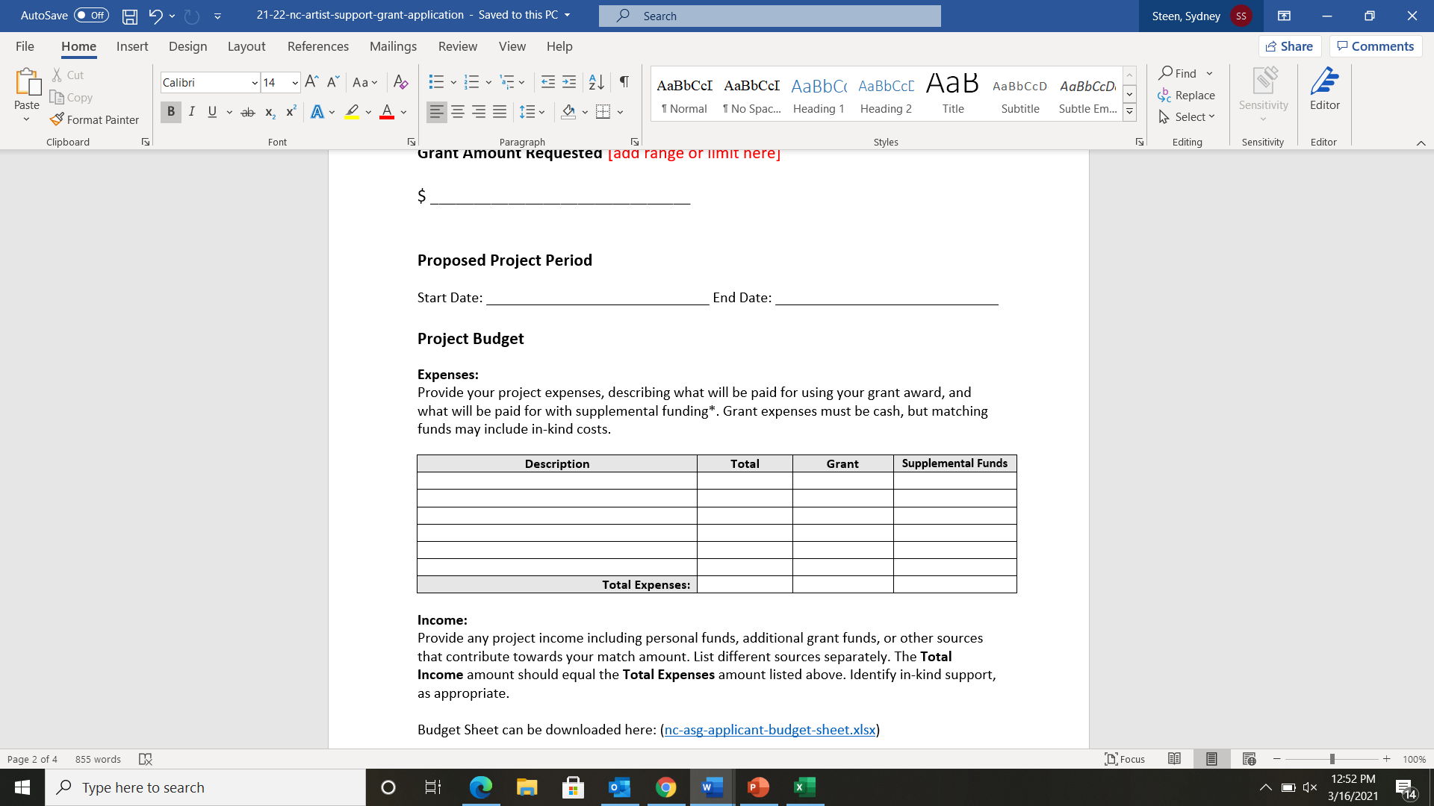
Budget/Expenses

Slide 25
Budget/Expenses: Provide as much detail as possible
Example
Mileage (200 mi. @ .535)
$107
Lodging (4 nights @ $85)
$340
Meals (5 days @ $35)
$175
$622

Slide 26
Budget/Expenses: Provide supporting documentation
For most equipment, airfares, and materials, prices can be found online. For professional services, request an estimate.
Always provide documentation for class, workshop, or conference registration costs.
If studying with a specific teacher is part of your proposal, explain why it is important to your growth and provide documentation of the teacher’s credentials.

Slide 27
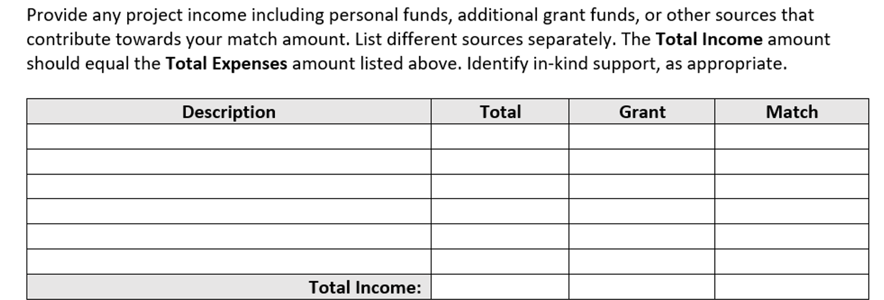
Budget/Income

Slide 28
Budget/Income: You are not required to spend your own money!
A match is NOT required
But, if you have other other sources of income that will contribute to the budget for the project, include that in the budget sheet.

Slide 29

Work sample descriptions and labeling
An inventory list of work samples should accompany the work samples you provide.
Work samples should be recent -three years or less.
The basic information is specific to each discipline. This will be explained in further detail on the next slides.

Slide 30

Visual art and craft work samples
Up to 10 images of your work.
Images must be high quality – not blurry or pixelated.
Description
In the inventory list, provide the title, date of completion, medium, and dimensions of the work you have uploaded to the application.

Slide 31

Music work samples
Documentation of up to three recorded performances. Audio or video samples should not exceed a total time of ten minutes.
Description
In the inventory list, include date and location of performance, title of piece, names of conductors, lead performers/musicians, etc. A short summary may also be included.
Composers and songwriters should also submit scores, lyrics, and/or lead sheets, as appropriate.

Slide 32

Film work samples
Documentation of one or more completed films.
Video clips should not exceed five minutes.
Description
In the inventory list, include date of work sample, title of piece, names and roles of key people, including directors, lead performers/actors, etc. A short summary may also be included.

Slide 33
Dance and performing arts work samples
Documentation of up to three recorded performances.
Videos should not exceed a total time of ten minutes.
Description
In the inventory sheet, include date and location of performance, title of piece, names and roles of key people, including choreographers and lead performers/dancers, etc. A short summary may also be included.

Slide 34

Writing work samples
Fiction, creative nonfiction, and playwrights may submit no more than 12 pages each of one to two manuscripts.
Poets may submit five to seven poems.
Playwrights may also submit documentation of a recorded performance or staged reading of their plays (videos not to exceed five minutes.)
Inventory list should include title of piece, when published, etc.

Slide 35
Support materials – résumés or bios
As a rule, they should be:
Artist résumés
Focus on your activities as an artist, including exhibitions, performances, readings, screenings, commissions, collections that have acquired your work, publishing history, residencies, articles and reviews of your work, workshops taught or taken, lectures, panels, education, employment, awards, etc.
Abbreviated
A suggested length is two-to-three pages.
If you have limited experience as an artist, focus on your existing artistic achievements in your resume and condense your other work experience into broad background information.
Make the case that the grant is especially important in taking a meaningful step forward in your artistic career.

Slide 36

Letters of Recommendation
Letters of recommendation are optional and they should always be the least important part of your proposal.
Have qualified references who can speak specifically and enthusiastically about your abilities as an artist.
Consider the following when choosing references:
  First-hand knowledge of your work as an artist
  Professional credentials (this is not a personal recommendation)
  How recent is the reference’s encounter with your work?

Slide 37
Review
Application checklist

Slide 38

Application checklist
Application profile
Narrative
Artist résumé: Attach an artist résumé that includes education, employment, public presentations of your work, publications, commissions, honors, grant or fellowship awards, and relevant experience. (four pages maximum)
Budget support: Provide support information for your budget, i.e., cost of materials, price quote on services, etc.
Support materials: You may submit reviews, programs, catalogs, and
other support materials relevant to the project.
Work samples and inventory list of samples provided

Slide 39

If you receive a grant
You will enter into a contractual agreement with [arts council name]
Promotional and marketing materials for the proposed project must use the N.C. Arts Council logo and credit line.
Funds must be spent by June 30, 2027.
Projects must be completed before December 31, 2027.

Slide 40



Thank you
@NCArts
@NCArtsCouncil
@NCArts

